Slide 1
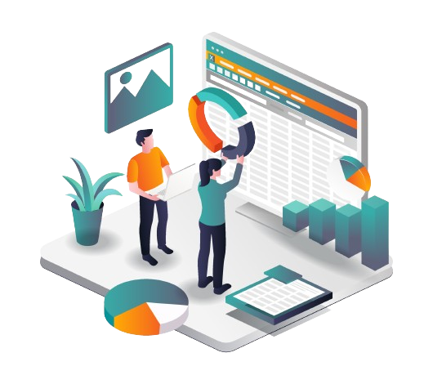

Customer Personality
Analysis

Slide 2

Introduction
Exploring Customer Personality Analysis using a Kaggle dataset to derive actionable insights for businesses through advanced analytics techniques like machine learning and data analysis. The goal is to improve marketing strategies, customer experiences, and decision-making for sustainable growth and competitive advantage.

Slide 3
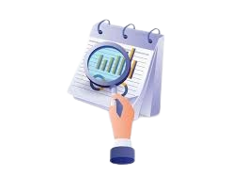
What Problem to Solve ?
Understanding customers is vital in business. This project uses KMeans unsupervised learning for Customer Segmentation Analysis to categorize customers based on characteristics and behaviors. The goal is to identify unique needs and provide tailored recommendations for each segment.
Algorithm Used ?
K Means Clustering
K-means clustering assigns data points to K clusters based on similarities defined by the user, minimizing distances by iteratively updating centroids to the mean of data points.

Slide 4
Data Analysis
AGENDA
Exploratory Data Analysis
Data Pre-Processing
Model Building
Model Evaluation & Interpretation
Conclusion
Importing Libraries & Loading Data
Gathering Information
Data Cleaning
Data Visualization
Dimension Reduction
Categorical Conversion
Feature Scaling
Correlation Analysis
PCA for Visualization
PCA for Feature Engineering
K-Mean Model building
Method Overview
Overall Insights
Final Cluster Conclusion
Model Evaluation
Model Interpretation
cluster Analysis
FIRST
SECOND
THIRD
FOURTH
FINAL

Slide 5
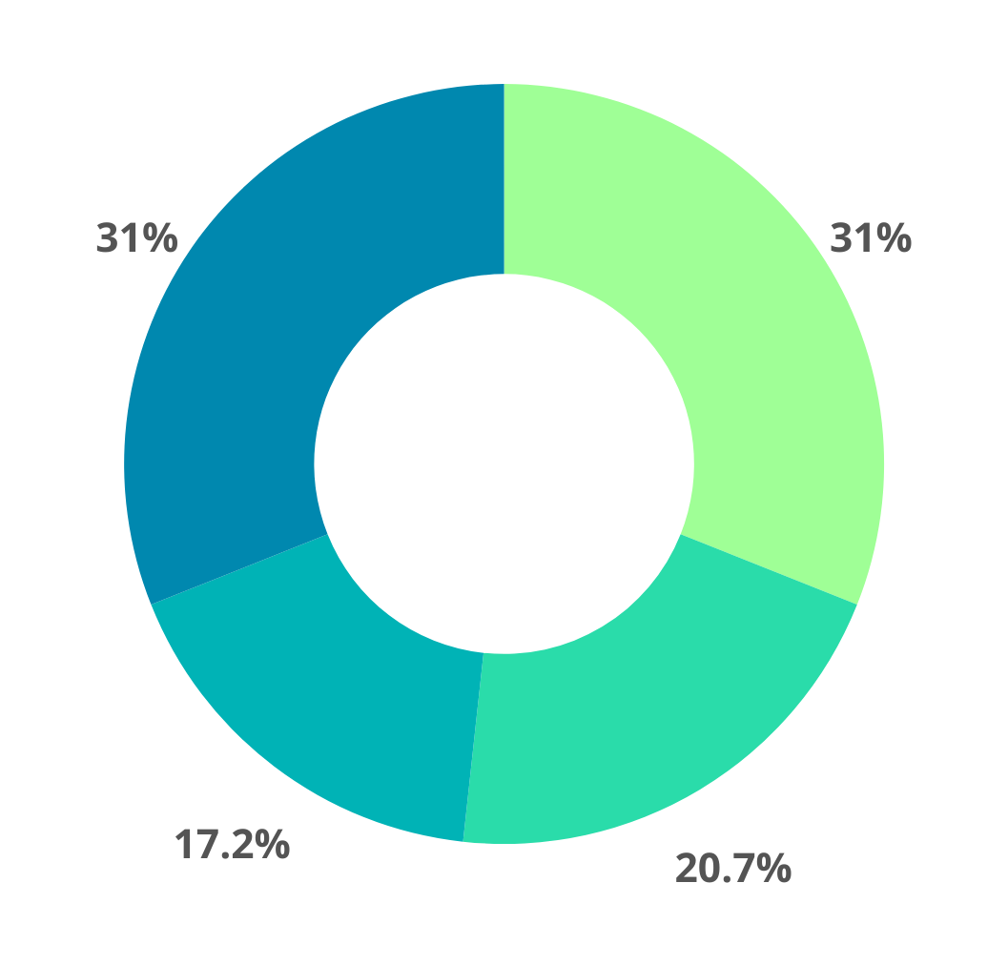




Features in Dataset
Personal Details
ID
Year Birth
Education
Marital_Status
Income
6. Kidhome
7. Teenhome
8. Dt_Customer
9. Recency
Products
MntWines
MntFruits
MntMeatProducts
4. MntFishProducts
5. MntSweetProducts
6. MntGoldProds
Places
NumDealsPurchases
NumDealsPurchases
NumDealsPurchases
4. NumStorePurchases
5. NumWebVisitsMonth
Promotional & Other
AcceptedCmp1
AcceptedCmp2
AcceptedCmp3
AcceptedCmp4
AcceptedCmp5
6. Complain
7. Z_CostContact
8. Z_Revenue
9. Response

Slide 6
Exploratory Data Analysis
Importing Libraries & Loading Data
Gathering Information
Data Cleaning
Data Visualization

Slide 7










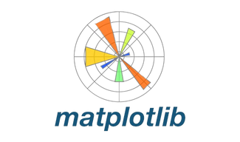




Libraries Used
Numpy
Seaborn
NumPy is a key Python library for numerical computing, enabling efficient manipulation of large arrays and matrices, along with comprehensive mathematical functions.
Seaborn is a statistical data visualization library in Python built on top of Matplotlib, providing high-level interface for drawing attractive and informative statistical graphics.
Pandas
Pandas is a powerful Python library for data manipulation and analysis, offering data structures and tools for handling structured data effectively.
Matplotlib
PYTHON LIBRARIES
Matplotlib is a python library used for creating static and interactive visualizations, offering extensive customization options for data analysis and presentation.
SkLearn
Scikit-learn is a powerful machine learning library in Python, offering tools for various tasks like classification, regression, clustering, dimensionality reduction and more with efficient algorithms and a user-friendly interface.
Warnings
Mpl_toolkits
Warnings library in Python enables developers to issue and manage warning messages, aiding in the detection of potential issues or deprecated features during program execution.
MPL_Toolkits enhances Matplotlib with extra tools and plot types, broadening its capabilities for diverse visualization tasks.

Slide 8





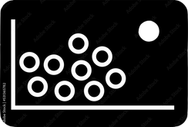
Loading Data & Gathering Information
URL :
https://www.kaggle.com/datasets/imakash3011/customer-personality-analysis
CATEGORICAL
NUMERICAL
MISSING
OUTLIERS
DUPLICATES
#
Education , Marital_Status and Dt_Customer has the categorical features i.e.
3 features
Except for Education, Marital_Status, and Dt_Customer, all the features are numerical i.e. 26 features
Income has 24 Null values i.e. around 1.071% of total data.
There were 1 outlier in Income feature with threshold of 200000 and 3 outliers in Age Feature with threshold of 90.
There is 0 Duplicate vales in the dataset.

Slide 9
Data Pre-Processing
Dimension Reduction
Categorical Conversion
Feature Scaling
Correlation Analysis

Slide 10
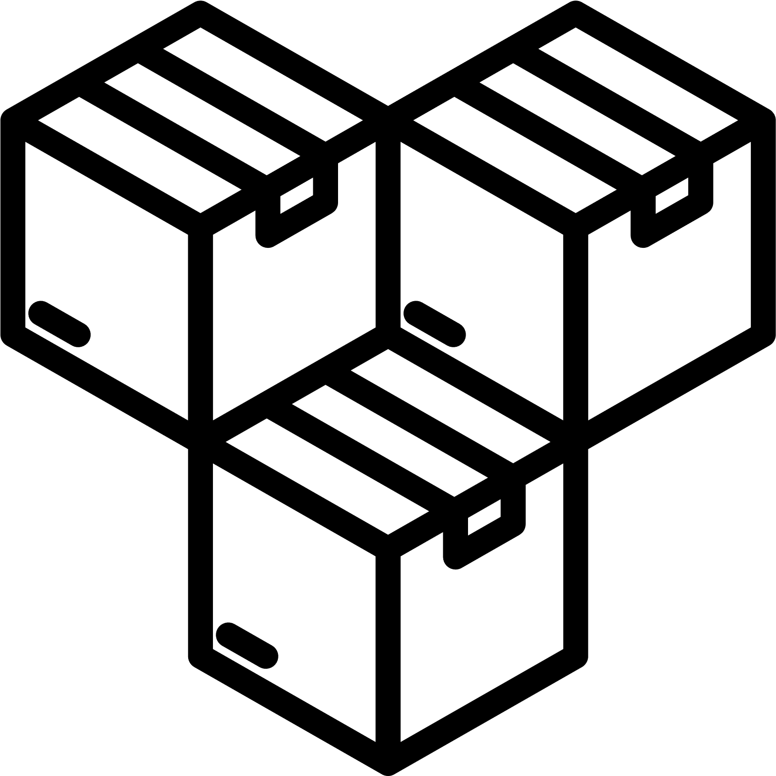





Dimension Reduction & Feature Selection
Creating some new features by combining the existing features.
Fruits
Fish
Sweets
Gold
Other_Product
NEW FEATURES
AcceptedCmp1
AcceptedCmp2
AcceptedCmp3
AcceptedCmp4
AcceptedCmp5
Response
Campaigns_Accepted
NumDealsPurchases
NumWebPurchases
NumCatalogPurchases
NumStorePurchases
Total_Purchases

Slide 11
Model Building
PCA for Visualization
PCA for Feature Engineering
K-Mean Model building

Slide 12
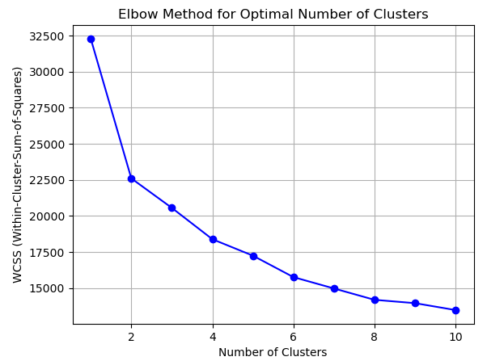
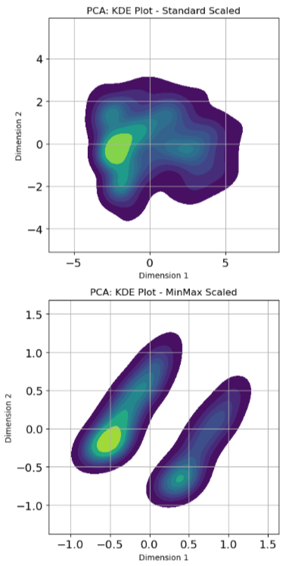
PCA for Visualization & Feature Engineer.
MinMax Scaler may not be ideal for datasets as I am getting two different clusters with a distance of 1. So I will go with Standard Scaler, it will be the best case for the PCA.
Here, we can create 3 or 4 clusters. When I attempted to use 4 clusters, it only resulted in 21 customers being grouped in that cluster, which is too few. Therefore, I will opt for 3 clusters.

Slide 13
Model Evaluation & Interpretation
Model Evaluation
Model Interpretation
Cluster Analysis

Slide 14
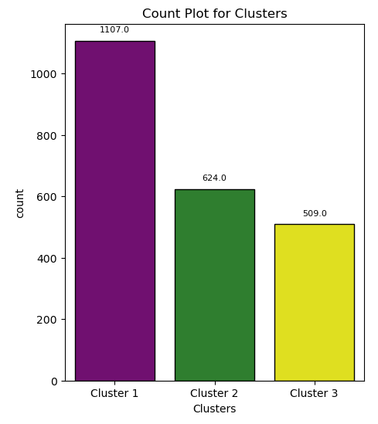
Model Evaluation
Count Plot for Clusters
Cluster 1 : 1107 customers i.e. around 50%
Cluster 2 : 624 customers i.e. around 28%
Cluster 3 : 509 customers i.e. around 22%

Slide 15
Conclusion
Method Overview
Overall Insights
Final Cluster Conclusion

Slide 16
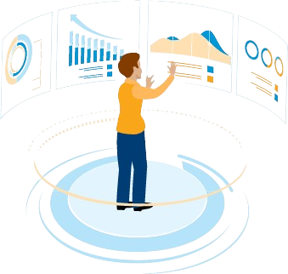
Overall Insights & Conclusion
Cluster 1:
Largest cluster, younger customers (30-40 age group), lower income.
Spends less on wine, meat, and products.
Mostly new customers, more web visits, lower total spending.
Cluster 2:
Moderate-sized, mixed ages with majority older (50+ age group) with children.
Higher incomes, moderate total spending, varying campaign acceptance.
Cluster 3:
Smallest cluster, older customers (60-80 age group), highest income.
Rarely have children, higher campaign acceptance.
Highest spending on wine, meat, products, highest total spending.

Slide 17


